Slide 1
Airbnb Data Analysis
Report by: Kavita Kumari

Slide 2
Objectives
Analyzing the customer satisfaction level for numerous stays.
Identifying the details of user experiences based on data.
To analyze the location wise prices and reviews.
Understanding the data on the basis of ratings.

Slide 3
Project Goals
The Aim is to identify the location with least favorable location scores.
Finding the relationship between host response time and the overall ratings.
Create a visualization based on prices which can help in analyzing the city wise data.
Preparing the composite score that integrates check in experience and host communication as per district.

Slide 4
Project Goals
Analyzing the age and tenure of the host in listings.
Prepare a tree map which displays the average price for various room type and property type.
Create a city wise report on the basis of listing prices, guest ratings and visitors trend.

Slide 5
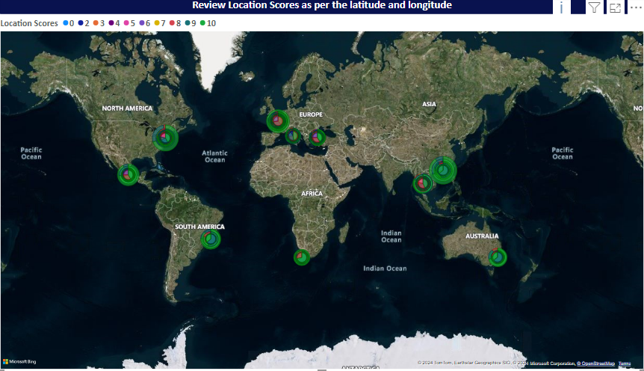

Slide 6
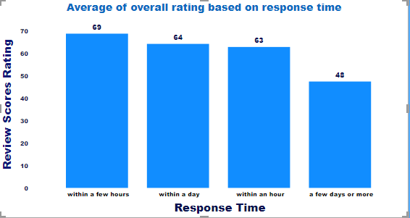

Slide 7
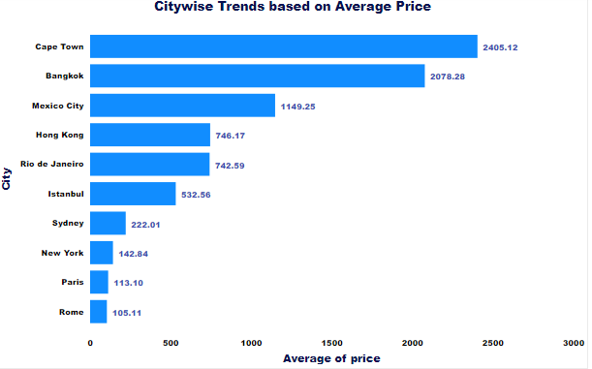

Slide 8
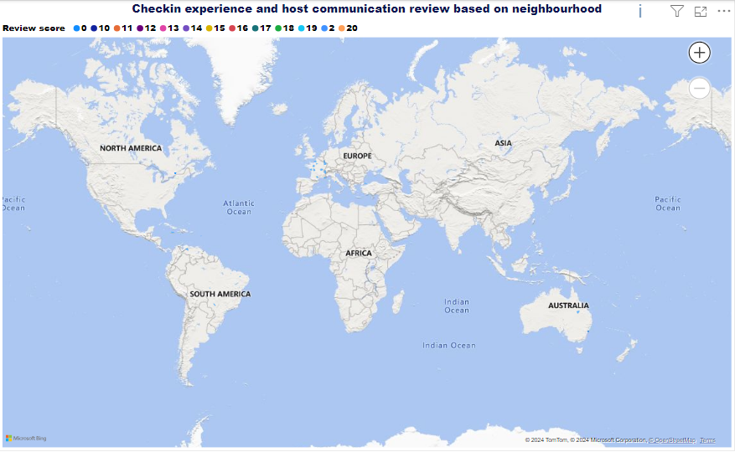

Slide 9
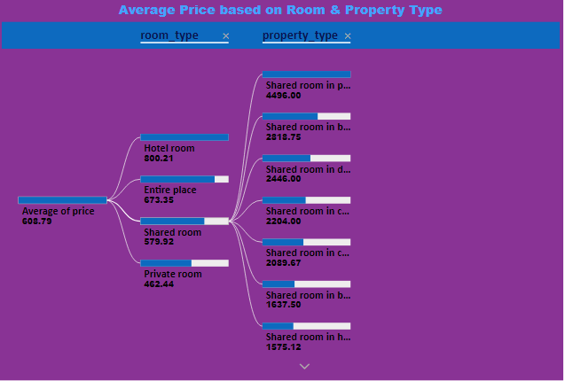

Slide 10
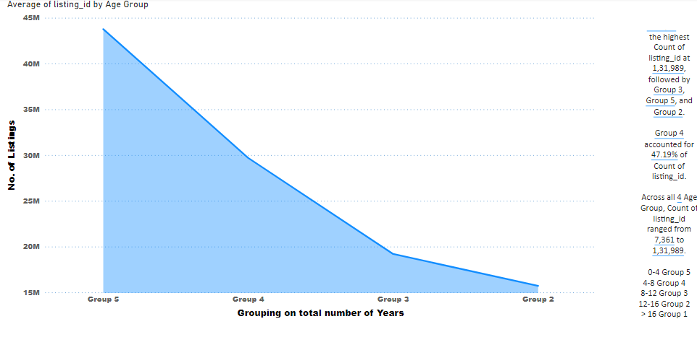

Slide 11
